Slide 1
Distributed System
Submitted to Dr. Ayaz
Submitted by:
Syed Taqi Ali (IS -009)
Bilal Ahmed Khan (IS-022)
Muhammad Anas (IS-023)

Slide 2
Private Cloud Setup with User Storage Management

Slide 3
Cloud Computing
Cloud computing provides computing, storage and software resources as services to users on-demand over the Internet.
Cloud computing has been increasingly gaining popularity.
Its access capability from any location, sharing of data across multiple data centers, and the management of data storage by the service providers.

Slide 4
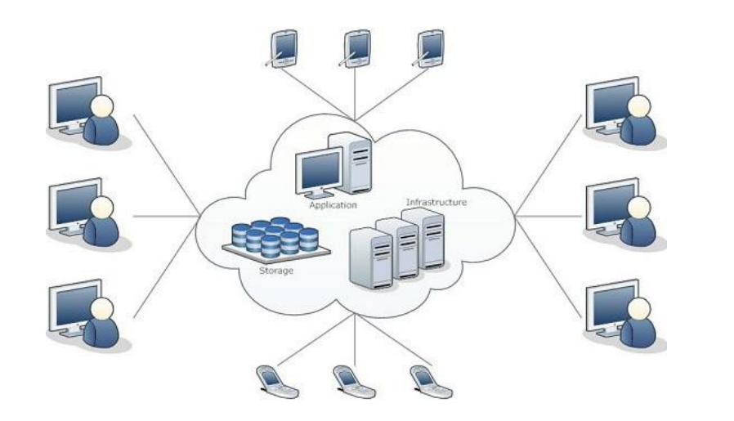
Cloud Computing Architecture

Slide 5
Basic Concepts
There are certain services and models working behind the scene making the cloud computing feasible and accessible to end users. Following are the working models for cloud computing:
1. Deployment Models
2. Service Models

Slide 6
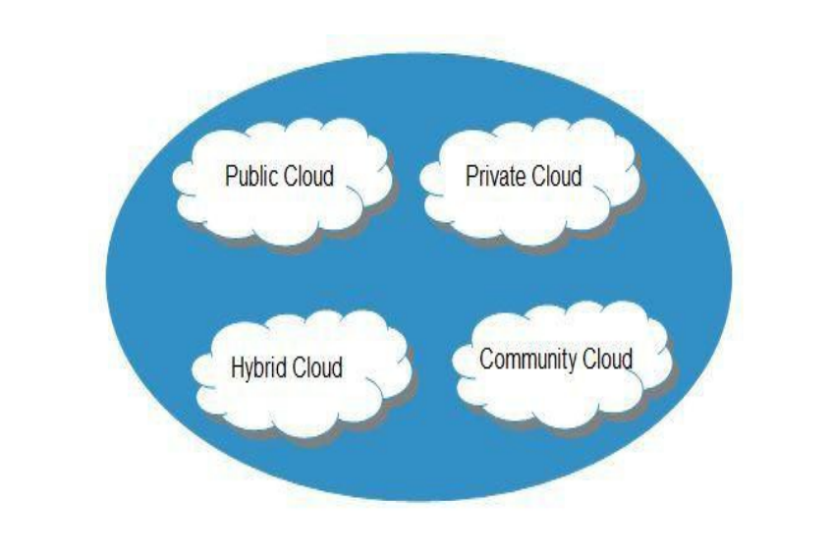
Cloud can have any of the four types of access:
Public, Private, Hybrid and Community.

Slide 7
Deployment Models
PUBLIC CLOUD : The Public Cloud allows systems and services to be easily accessible to the general public. Public cloud may be less secure because of its openness, e.g., e-mail.
PRIVATE CLOUD : The Private Cloud allows systems and services to be accessible within an organization. It offers increased security because of its private nature.

Slide 8
Deployment Models
COMMUNITY CLOUD : The Community Cloud allows systems and services to be accessible by group of organizations.
HYBRID CLOUD : The Hybrid Cloud is mixture of public and private cloud. However, the critical activities are performed using private cloud while the non-critical activities are performed using public cloud.

Slide 9
Service Models
Service Models are the reference models on which the Cloud Computing is based. These can be categorized into three basic service models as listed below:
1.Infrastructure as a Service (IaaS)
2. Platform as a Service (PaaS)
3. Software as a Service (SaaS)

Slide 10
Service Models
Storage as a Service (STaaS), it allows users to store their data at remote disks and access them anytime from any place.

